Slide 2
Timeline of CM Budget News
January 2021: Governor Cuomo proposed a 28.5 billion spending plan for education (CM was getting a 0% increase in state aid)
“Cuomo’s proposal still cuts the state’s contribution to schools by more than $600 million” Source: Chalkbeat: January 19th, 2021
April 2021: Additional $29.5 billion in aid to NYS schools
Cato-Meridian CSD is expecting an increase of $788,079. in NYS State Aid

Slide 3
Budget Priorities:
Planning for the Future
Strategic Plan Focus-Multi Year Goals
Success for All (ELA Focus)
Wellness (Social-Emotional Supports)
Facilities (Building Condition Survey)

Slide 4
Educational Programs:
Planning for the Future
Library Media Specialist
Music Teacher
Summer Programs
Literacy Coach
Technology Replacement Plan
Capital Project

Slide 5
2021-2022 Other Budget Benefits
Class sizes remain relatively small
No Tax Cap increase
Capital Outlay Project

Slide 6
Budget Development
2019-2020 Approved Budget: $21,842,479
2020-2021 Approved Budget: $20,893,690
2021-2022 Proposed Budget: $22,459,281

Slide 7
2021-2022 ANTICIPATED EXPENDITURE BUDGET
Description | 2020-2021 | 2021-2022 | $ Change | % Change
ADM | $2,002,211 | $2,084,141 | 81,930 | 4.09%
PROGRAM | $14,169,368 | $15,444,436 | 1,275,068 | 9.00%
CAPITAL | $4,722,111 | $4,930,704 | 208,593 | 4.42%
Total Budget | $20,893,690 | $22,459,281 | 1,565,591 | 7.49%

Slide 8
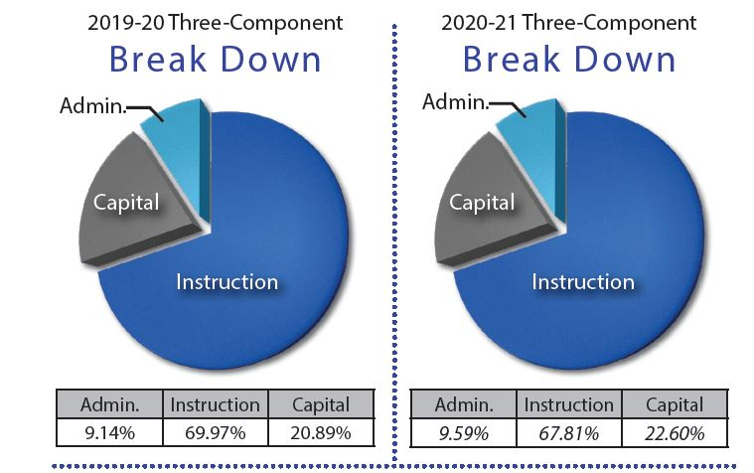
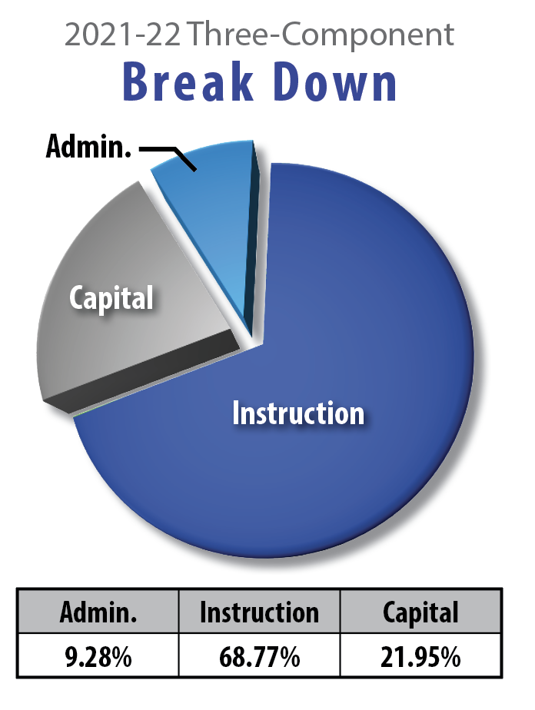

Slide 9
2021-2022 State Aid
$ 788,009 year to year State Aid Increase
State is gradually returning Foundation Aid to District

Slide 10
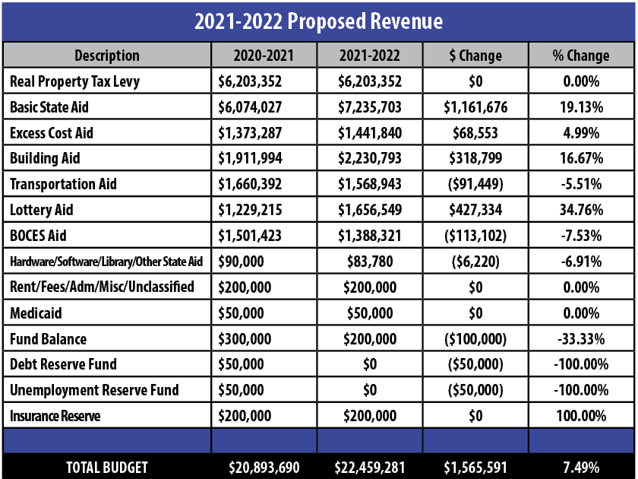
0.00%

Slide 11
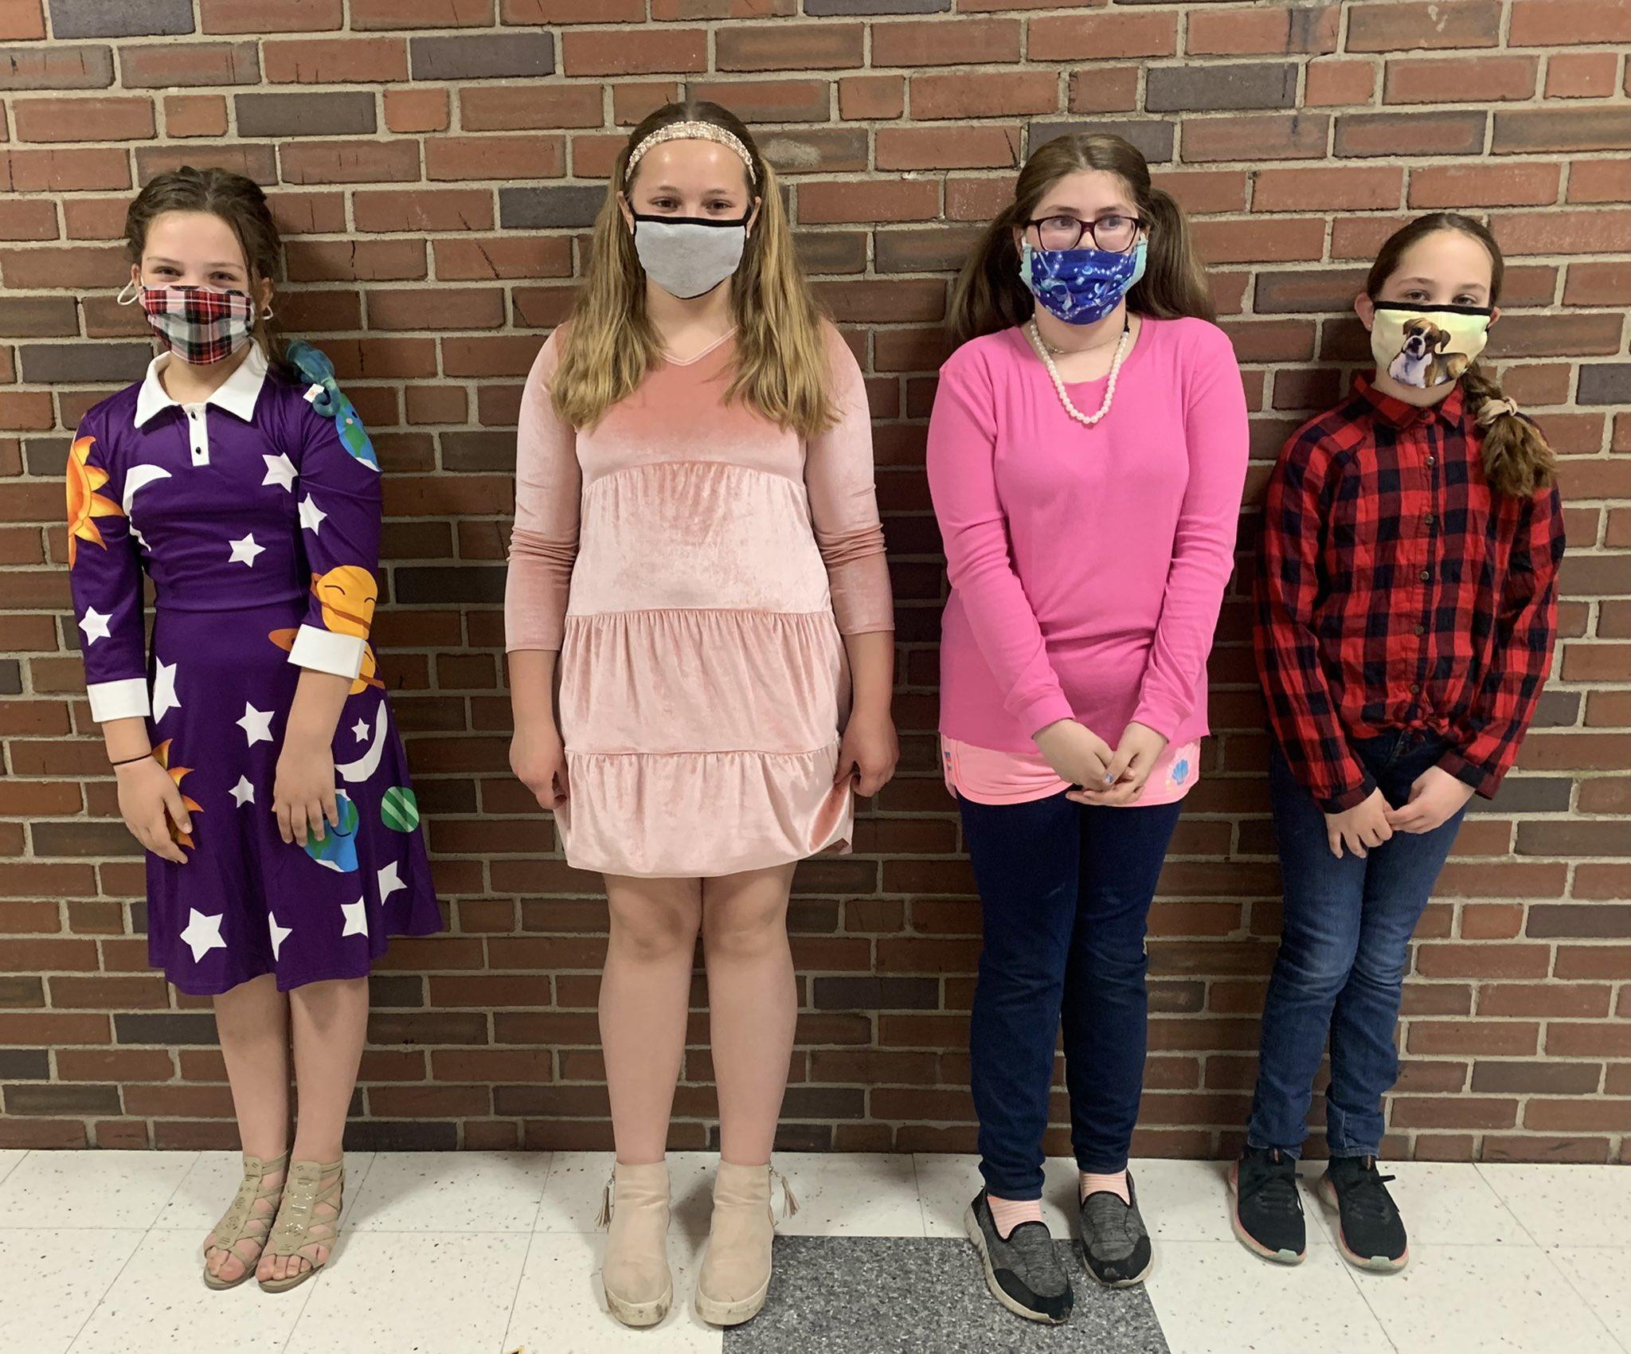
Vehicle Proposition: $303,791
Current transportation aid ratio – 90%
Two 65 Passenger Buses
One 30 Passenger Bus

Slide 12
Property Tax Report Card Comparison
 | 2018-2019 | 2019-2020 | 2020-2021 2021-2022
Total Proposed Spending | $21,360,267 | $21,842,479 | $20,893,690 $22,459,281
Total Proposed Tax Levy | $5,939,206 | $6,087,686 | $6,203,352 $6,203,352
Permissible Exclusions | $244,266 | $348,199 | $496,606 $400,587
School Tax Levy Limit Less Exclusions | $5,694,940 | $5,845,793 | $5,802,201 $5,731,334
Proposed Levy Less Exclusions | $5,644,940 | $5,664,487 | $5,631,746 $5,727,765

Slide 13
HISTORICAL TAX LEVY
YEAR | 2014-15 | 2015-16 | 2016-17 | 2017-18 | 2018-19 | 2019-20 | 2020-2021 | 2021-22
TAX LEVY | 1.40% | 1.56% | .37% | 0% | 2.23% | 2.50% | 1.90% | 0%
TRUE TAX PER $1000 | $18.32 | $18.44 | $18.19 | $18.14 | $18.25 | $18.06 | $18.42 | $18.42*
 |  |  |  |  |  | *ESTIMATE

Slide 14
2021-2022 Budget Recap
Proposition #1: 2021-2022 Proposed Budget of $22,459,281
Fully fund the EBALR reserve fund
Capital outlay project of lighting for pathway between two school buildings

Slide 15
2020-2021 Budget Recap
Proposition #2:
District will be purchasing the following vehicles:
- Two 65 passenger buses
- One 30 passenger bus

Slide 16
Annual Budget Vote
May 18, 2021
All voting can be done in-person at Cato-Meridian Elementary
Absentee ballots can be obtained from the District Clerk
All absentee ballots are due in the District Office no later than 4:00 pm on May 18th, 2021 via the United States Postal Service
PLEASE VOTE!!

